Slide 1
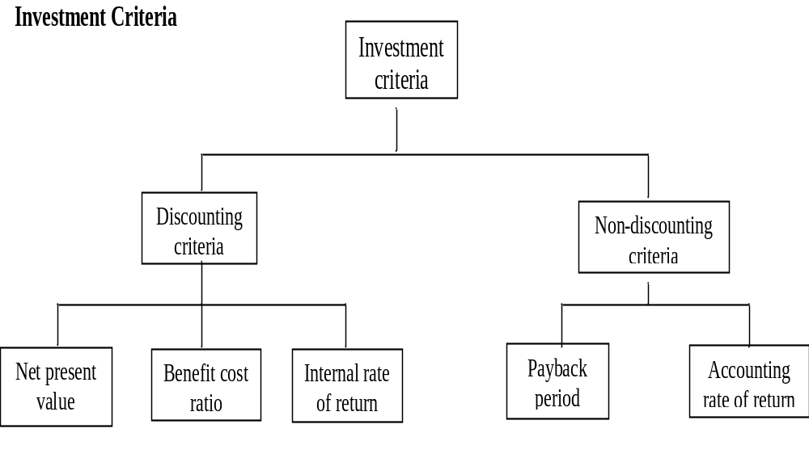

Slide 2
NET PRESENT VALUE
The net present value (NPV) of a project is the sum of the present values of all the cash flows – positive as well as negative – that are expected to occur over the life of the project. The general formula of NPV is:
Ct = cash flow at the end of year t
n = life of the project
r = discount rate

Slide 3
To illustrate the calculation of net present value, consider a project which has the following cash flow stream:
Year Cash Flow
0 Rs. (1,000,000)
1 200,000
2 200,000
3 300,000
4 300,000
5 350,000

Slide 4

The cost of capital, r, for the firm is 10 percent. The net present value of the proposal is:
BENEFIT COST RATIO
There are two ways of defining the relationship between benefits and costs:
Where PVB = present value of benefits
I = initial investment

Slide 5

To illustrate the calculation of these measures, let u consider a project which is being evaluated by a firm that has a cost of capital of 12 per cent.
Initial investment: Rs.100,000
Benefits: Year 1 25,000
Year 2 40,000
Year 3 40,000
Year 4 50,000
NBCR = BCR – 1 = 0.145

Slide 6
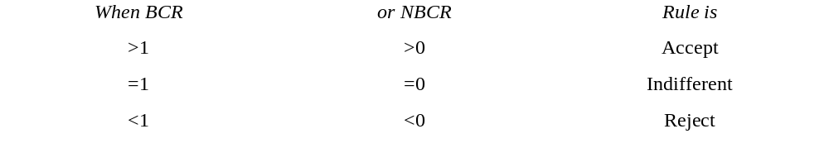
The two benefit cost ratio measures, because the difference between them is simply unity, give the same signals. The following decision rules are associated with them.
The proponents of benefit cost ratio argue that since this criterion measures net present value per rupee of outlay, it can discriminate better between large and small investments and hence is preferable to the net present value criterion.

Slide 7
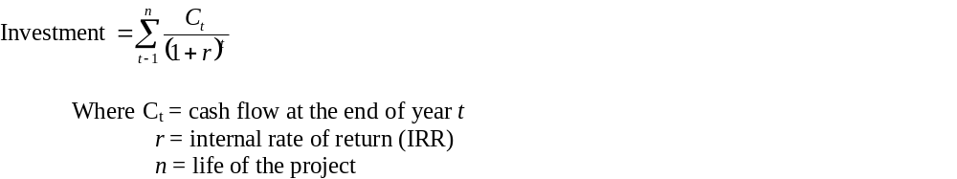
Internal Rate of Return
The internal rate of return (IRR) of a project is the discount rate which makes its NPV equal to zero. Put differently, it is the discount rate which equates the present value of future cash flows with the initial investment. It is the value of r in the following equation:
In the NPV calculation we assume that the discount rate (cost of capital) is known and determine the NPV. In the IRR calculation, we set the NPV equal to zero and determine the discount rate that satisfies this condition.

Slide 8

To illustrate the calculation of IRR, consider the cash flows of a project being considered by Techtronic Limited:
The calculation of r involves a process of trial and error. We try different values of r till we find that the right-hand side of the above equation is equal to 100,000.
Year | 0 | 1 | 2 | 3 | 4
Cash Flow | (100,000) | 30,000 | 30,000 | 40,000 | 45,000

Slide 9
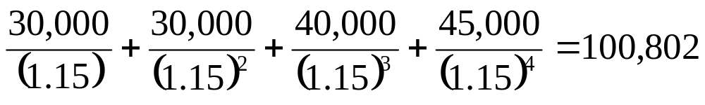
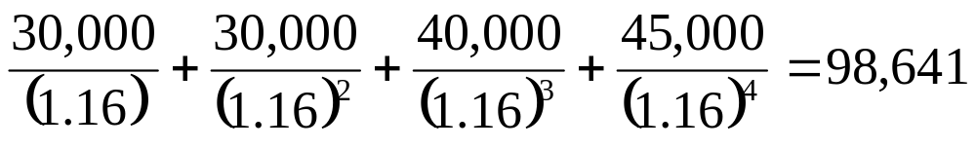
Let us, to begin with, try r = 15 per cent. This makes the right-hand side equal to:
This value is slightly higher than our target value, 100,000. SO we increase the value of r from 15 per cent to 16 per cent. (In general, a higher r lowers and a smaller r increases the right-hand side value). The right-hand side becomes

Slide 10
Since this value is now less than 100,000, we conclude that the value of r lies between 15 per cent and 16 per cent. For most of the purposes this indication suffices.
If a more refined estimate of r is needed, use the following procedure:
Determine the net present value of the two closest rates of return.
(NPV / 15 per cent) 802
(NPV / 16 per cent) (1,359)

Slide 11
2. Find the sum of the absolute values of the net present values obtained in step 1.
802+1,359 = 2,161
Calculate the ratio of the net present value of the smaller discount rate, identified in step 1, to the sum obtained in step 2:
802
------- = 0.37
2,161

Slide 12
4. Add the number obtained in step 3 to the smaller discount rate:
15+0.37 = 15.37 per cent
The internal rate of return, calculated in this manner, is a very close approximation to the true internal rate of return.
The decision rule for IRR is as follows:
Accept: If the IRR is greater than the cost of capital
Reject: If the IRR is less than the cost of capital

Slide 13
PAYBACK PERIOD
The payback period is the length of time required to recover the initial cash outlay on the project.
For example, if a project involves a cash outlay of Rs.600,000 and generates cash inflows of Rs.100,000, Rs.150,000, Rs.150,000, and Rs.200,000, in this first, second, third, and fourth years, respectively, its payback period is 4 years because the sum of cash inflows during 4 years is equal to the initial outlay.
When the annual cash inflow is a constant sum, the payback period is simply the initial outlay divided by the annual cash inflow.

Slide 14
For example, a project which has an initial cash outlay of Rs.1,000,000 and a constant annual cash inflow of Rs.300,000 has a payback period of Rs.1,000,000/300,000=3 1/3 years.
According to the payback criterion, the shorter the payback period, the more desirable the project.
Firms using this criterion generally specify the maximum acceptable payback period.
If this is n years, projects with a payback period of n years or less are deemed worthwhile and projects with a payback period exceeding n years are considered unworthy.

Slide 15
DISCOUNTED PAYBACK PERIOD
A major shortcoming of the conventional payback period is that it does not take into account the time value of money.
To overcome this limitation, the discounted payback period has been suggested.
In this modified method, cash flows are first converted into their present values (by applying suitable discounting factors) and then added to ascertain the period of time required to recover the initial outlay on the project.

Slide 16
ACCOUNTING RATE OF RETURN
The numerator of this ratio may be measured as the average annual post-tax profit over the life of the investment and the denominator is the average book value of fixed assets committed to the project.
The accounting rate of return, also called the average rate of return,
is defined as
Profit after tax
------------------------------------
Book value of the investment

Slide 17
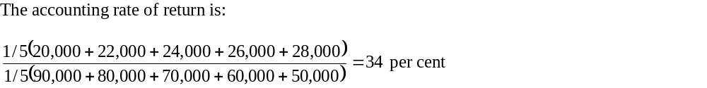
To illustrate the calculation consider a project:
Year | Book value of fixed investment | Profit after tax (Rs.)
1 | 90,000 | 20,000
2 | 80,000 | 22,000
3 | 70,000 | 24,000
4 | 60,000 | 26,000
5 | 50,000 | 28,000

Slide 18
Obviously, the higher the accounting rate of return, the better the project.
In general, projects which have an accounting rate of return equal to or greater than a pre-specified cut-off rate of return- which is usually between 10 per cent and 30 per cent – are accepted; other are rejected.

Slide 19
INVESTMENT APPRAISAL IN PRACTICE
A survey of capital budgeting practices in India, conducting by U. Rao Cherukeri, revealed the following:
Over time, discounted cash flow methods have gained in importance and internal rate of return is the most popular evaluation method.
Firms typically use multiple evaluation methods.
Accounting rate of return and payback period are widely employed as supplementary evaluation methods.

Slide 20
Weighted average cost of capital is the most commonly used discount rate and the most often used discount rate is 15 percent in post-tax terms.
Risk assessment and adjustment techniques have gained popularity. The most popular risk assessment technique is sensitivity analysis and the most common methods for risk adjustment are shortening of the payback period and increasing the required rate of return.

Slide 21
CAPITAL BUDGETING
INTRODUCTION:
An efficient allocation of capital is the most important finance function in the modern times. It involves decisions to commit the firm’s funds to the long-term assets. Such decisions are of considerable importance to the firm since they tend to determine the value size by influencing its growth, profitability and risk.

Slide 22
NATURE OF INVESTMENT DECISIONS
The investment decisions of a firm are generally known as the capital budgeting, or capital expenditure decisions. A capital budgeting decision may be defined as the firm’s decision to invest its current funds most efficiently in the long-term assets in anticipation of an expected flow of benefits over a series of years. The long-term assets are those which affect the firm’s operations beyond the one-year period. The firm’s investment decisions would generally include expansion, acquisition, modernisation and replacement of the long-term assets. Sale of a division or business is also analysed as an investment decision. Activities such as change in the methods of sales distribution, or undertaking an advertisement campaign or a research and development programme have long-term implications for the firm’s expenditures and benefits, and therefore, they may also be evaluated as investment decisions. It is important to note that investment in the long-term assets invariably requires funds to be tied up in the current assets such as inventories and receivables. As such, investment in fixed and current assets is one single activity.

Slide 23
The following are the features of investment decisions:
The exchange of current funds for future benefits.
The funds are invested in long-term assets
The future benefits will occur to the firm over a series of years.
It is significant to emphasise that expenditures and benefits of an investment should be measured in cash. In the investment analysis, it is cash flow which is important, not the accounting profit. It may also be pointed out that investment decisions affect the firm’s value. The firm’s value will increase if investments are profitable and add to the shareholders’ wealth. Thus, investments should be evaluated on the basis of a criterion which is compatible with the objective of the shareholders’ wealth maximisation. An investment will add to the shareholders’ wealth if it yields benefits in excess of the minimum benefits as per the opportunity cost of capital.

Slide 24
Importance of Investment Decisions:
Investment decisions require special attention because of the following reasons:
They influence the firm’s growth in the long run
They affect the risk of the firm
They involve commitment of large amount of funds
They are irreversible, or reversible at substantial loss
They are among the most difficult decisions to make

Slide 25
Growth The effects of investment decisions are extend into the future and have to be endured for a longer period than the consequences of the current operating expenditure. A firm’s decision to invest in long-term assets has a decisive influence on the rate and direction of its growth. A wrong decision can prove disastrous for the continued survival of the firm; unwanted or unprofitable expansion of assets will result in heavy operating costs to the firm. On the other hand, inadequate investment in assets would make it difficult for the firm to compete successfully and maintain its market share.
Risk A long-term commitment of funds may also change the risk complexity of the firm. If the adoption of an investment increases average gain but causes frequent fluctuations in its earnings, the firm will become more risky. Thus, investment decisions shape the basic character of a firm.
Funding Investment decisions generally involve large amount of funds which make it imperative for the firm to plan its investment programmes very carefully and make an advance arrangement for procuring finances internally or externally.

Slide 26
Irreversibility Most investment decisions are irreversible. It is difficult to find a market for such capital items once they have been acquired. The firm will incur heavy losses if such assets are scraped.
Complexity Investment decisions are among the firm’s most difficult decisions. They are an assessment of future events which are difficult to predict. It is really a complex problem to correctly estimate the future cash flow of an investment. The uncertainty in cash flow is caused by economic, political, social and technological forces.

Slide 27
Types of investment Decisions
There are many way to classify investments. One classification is as follows:
Expansion of existing business
Expansion of new business
Replacement and modernisation

Slide 28
DEFINITION
Capital budgeting is concerned with designing and carrying through a systematic investment program. The capital budget is essentially a list of what management believes to be worthwhile projects for the acquisition of new capital assets together with the estimated cost of each project. Each proposal is accompanied by a justification.
A capital expenditure is a cash outlay that is expected to generate a flow of future cash benefits lasting longer than one year. It is distinguished from a normal operating expenditure, which is expected to result in cash benefits during the coming one-year period. Capital budgeting is the process of planning for and evaluating capital expenditures.
In addition to asset replacement and expansion decisions, other types of decisions that can be analyzed using capital budgeting techniques include research and development expenditures, investments in employee education and training, lease-versus-buy decisions, and mergers and acquisitions.
The importance of capital expenditures to a firm is derived from the fact that current capital outlays, by definition, have a long-range impact on the performance of the enterprise. These current outlays affect future profitability, and in aggregate they plot the future direction of the firm by determining the products that will be produced, markets to be entered, the location of plants and facilities, and the type of technology (with associated costs) to be used. Capital expenditures require careful analysis because they are both costly to make and difficult to reverse without incurring considerable costs.

Slide 29
The capital budgeting process:
The process of selecting capital investment projects consist of the following important steps:
Identification of potential investments
Estimate cash flows for the project proposals
Evaluate and choose, from the alternatives available, those investment projects to implement.
Implementation
Review the investment projects.

Slide 30
Capital expenditures represent the growing edge of a business. Capital budgeting is perhaps the most important issue in corporate finance. How a firm finances its investments and how it manages its short-term operations are definitely issues of concern but how it allocates its capital really reflects its strategy and its business. That is why it is also referred to all strategic assets allocation.
Given the crucial significance of capital budgeting decisions, it is not surprising that firms spend considerable time in planning these decisions and involve top executives from production, engineering, marketing, and son on, in evaluating capital expenditure proposals-these decisions are too important to be left to financial managers alone.

